Slide 1
LAB Customization Playbook
WORK IN PROGRESS

Slide 2
Lorum ipsum dolor
Sample text
VK 14.Sep.20: Provide information on what is available and what is possible in LAB to support your learning needs
Outline key questions to best understand needs/objectives for the platform
Provide information on ways in which we can engage and process
Objectives for this playbook
Shobhit 16.Sep.20: Additional ideas to keep / incorporate / ignore based on final scope of the document we land with –
Familiarize you with some of the personalization features of LAB available to you and your learners
Outline key questions for you to consider as you look to customize / personalize the LAB experience for your learners
Share some examples of how LAB is being used today
Outline key decision points that can help you choose from the available personalization options

Slide 3
Make LAB your learning destination
VK 28.Sep.20: Use any of the marketing slides from the Get to Know LAB deck?
https://bcg01.egnyte.com/dl/mDpQMSyS8B

Slide 4
LAB is designed to be a one-stop learning destination
VK 28.Sep.20: I combined these into one slide in the interest of reducing slide volume. But, if we want to highlight self-directed customization separately, would break these out.
Native
Experience the full BCG learning catalog, as well as favorite external content,
plus exciting new formats
Navigation offers many ways through which to discover content
Mobile app enables on-the-go and offline learning that syncs progress to the desktop
Self-directed
My Plan page centralizes all assigned, started, or completed learning
Bookmark and organize learning to build topic- or interest-based collections
Follow topics of interest to cultivate a unique learning journey, with featured content delivered directly to the home page

Slide 5


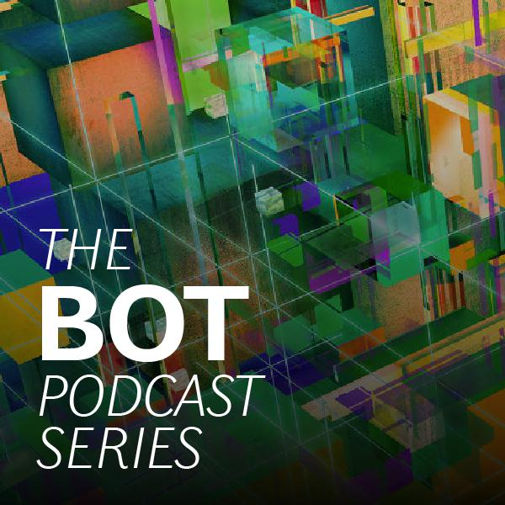

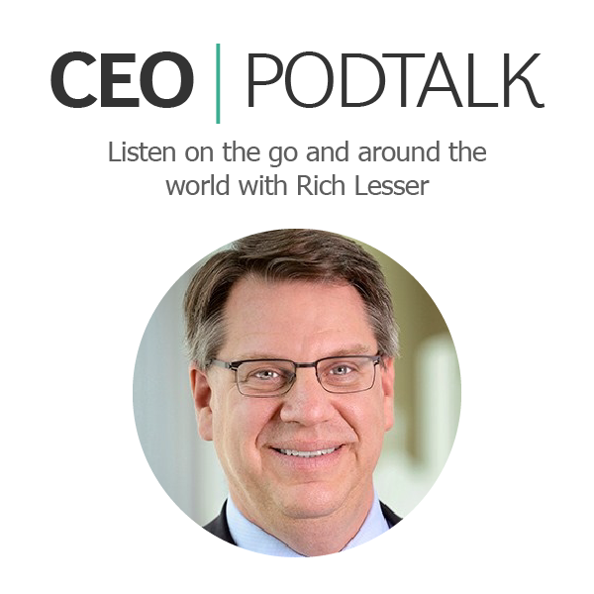
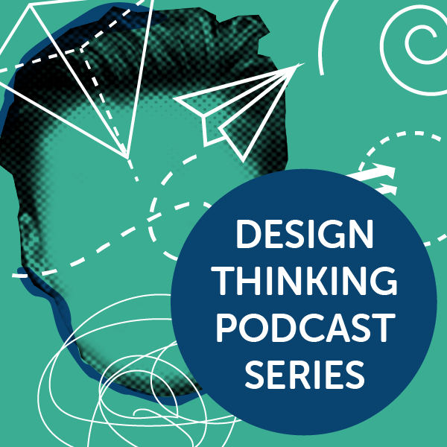





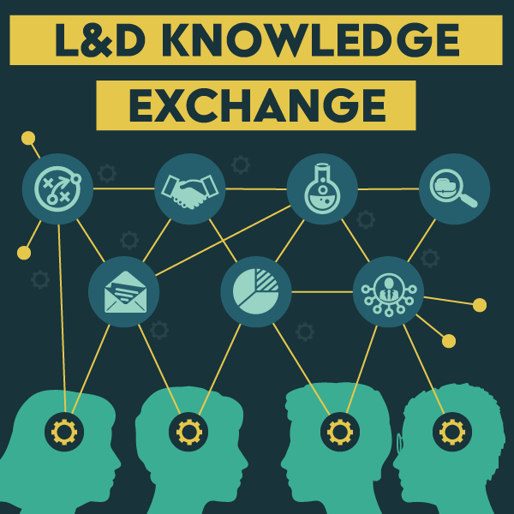


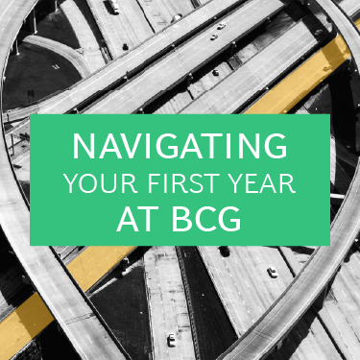


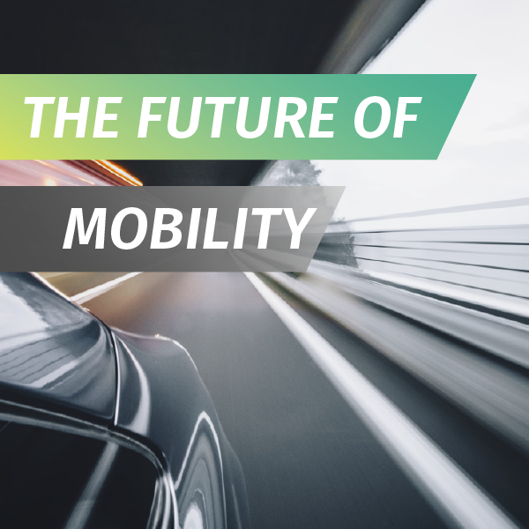





Our content library offers a variety of topics for all cohorts
VK 28.Sep.20: example from LABcasts playbook – should we include something like this about what is available in LAB?
Pipeline
Current series
Future of the planet/ Climate change
Your idea here!
Leading Change
MDT Season 2

Slide 6
Tailor LAB to fit your learner's needs
RP 15.Sep.20:
Canvas- tailored look and feel, and navigation I know we don't want to open this up for a full redesign but I think we need to be clear that there is a lot of flexibility how to arrange the page, what links to have on canvas etc.
RP 15.Sep.20:
Announcements portlet
My Learning
Discover
Portlets
RP 15.Sep.20: Maybe adding something about the capability to offer curated journeys per person's role, career step etc. (referring to learning journey workspaces – which may later on be in LXP)
VK 14.Sep.20: Add examples as backup
Shobhit 16.Sep.20: Like the idea of adding curation + journeys here
Might there be a way of segmenting what's 'core' functionality (e.g. search, browse, mobile, blended format) and 'personalization' functionality (e.g. look and feel, subscriptions).
This might allow us to define scope of this document, and focus on the personalization features
This might also allow us to further segment the personalization features into (a) learner-led / self-directed (e.g. subscriptions, collections) and (b) L&D/business-led (e.g. canvas, portlets, workspaces, pages)
RP 15.Sep.20: Workspaces: I might misunderstand the collaboration part on workspaces but so far we have not allowed users (learners) to modify or contribute to the workspaces, only to group pages..
Current key use case for workspaces is to provide curated learning journey.
We hope to convert all workspaces to pages once pages –feature is developed enough. For more info on pages feature, check the wave 2 core team meeting minutes from July 14th.
Shobhit 16.Sep.20: Re. default groups – I would position this as a consideration / requirement for some of the personalization features and not a feature in itself.
RP 15.Sep.20: Groups:
I would mention that person belongs to a certain default group based on their profile in core HR. In addition to this, they can be added to other groups per their position/role and learnings they attend.
Once the L&D Group page is more built (Bryce is working on this), we should add a screenshot from that as an example.

Slide 7
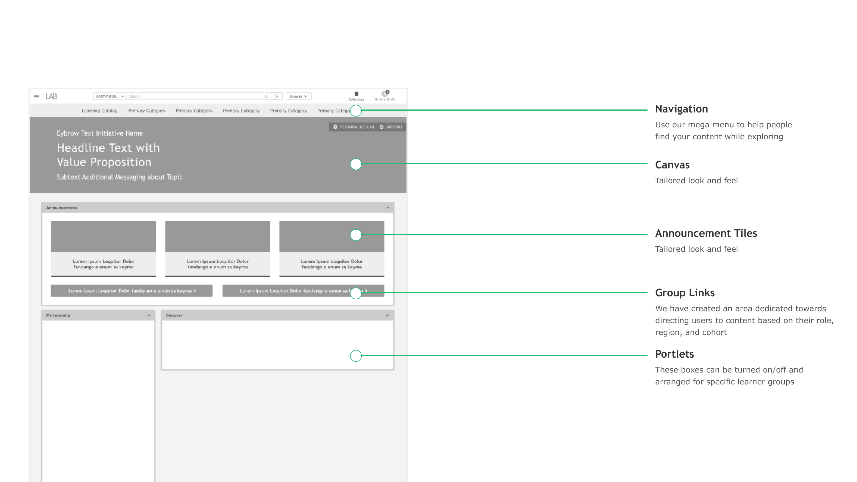
Customizations | LAB Landing

Slide 8
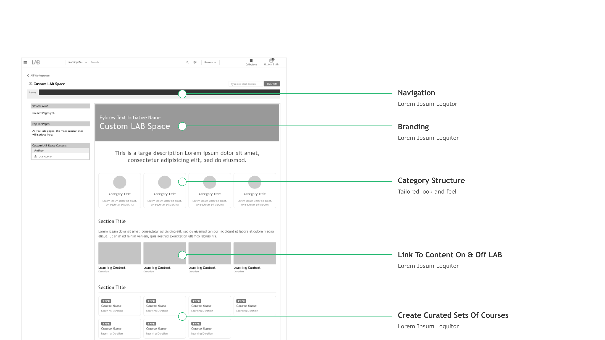
Customizations | LAB Spaces

Slide 9
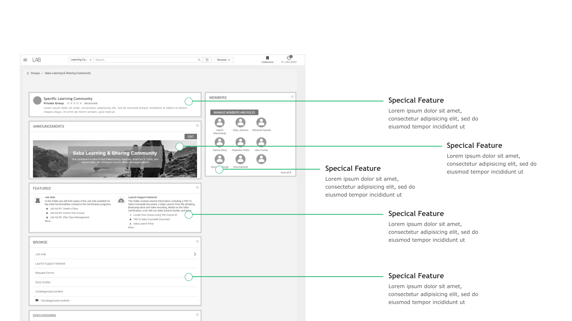
Customizations | LAB Social Group

Slide 10
How we can partner with you

Slide 11
LAB is supported by the Global L&D Team
VK 28.Sep.20: example
Who are the right people for this slide from L&D and systems team
Tom Guillou
Platform & Analytics Director
Boston
Series design and measurement/ communications strategy, best practices for recording content, editing
Kate Venier
Global L&D Senior Manager
Boston
PM for Podcast App, Instructional Design, Learner Experience
Shobhit Bajaj
Global L&D Senior Manager
London
Scheduling, technical logistics (equipment, day-of support), and support

Slide 12
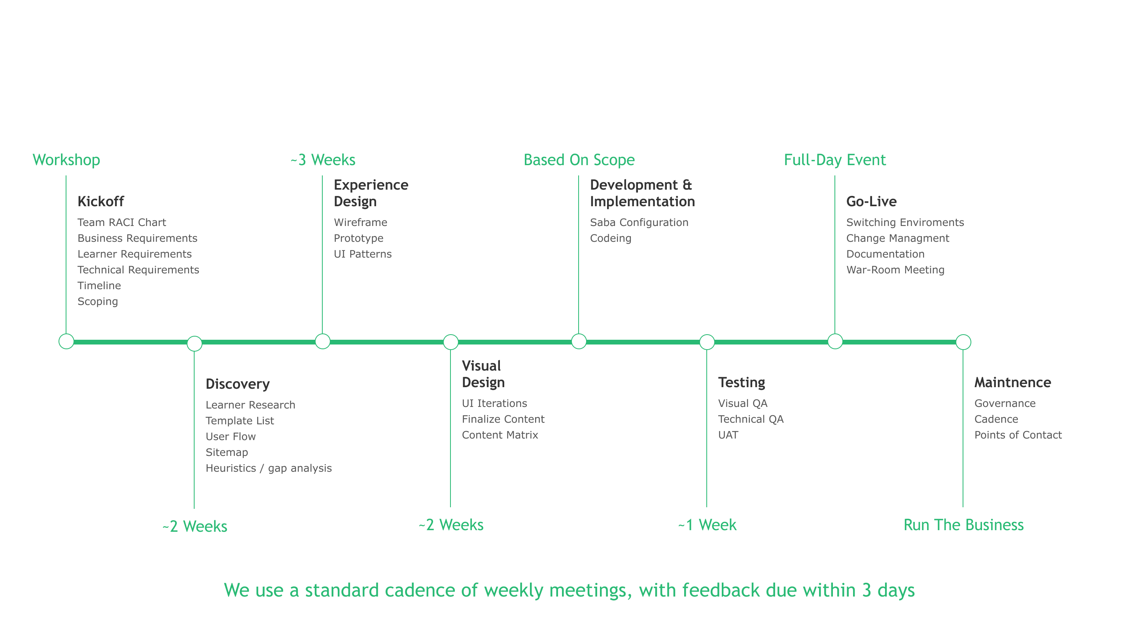
Lifecycle of a Customized LAB Experience

Slide 13
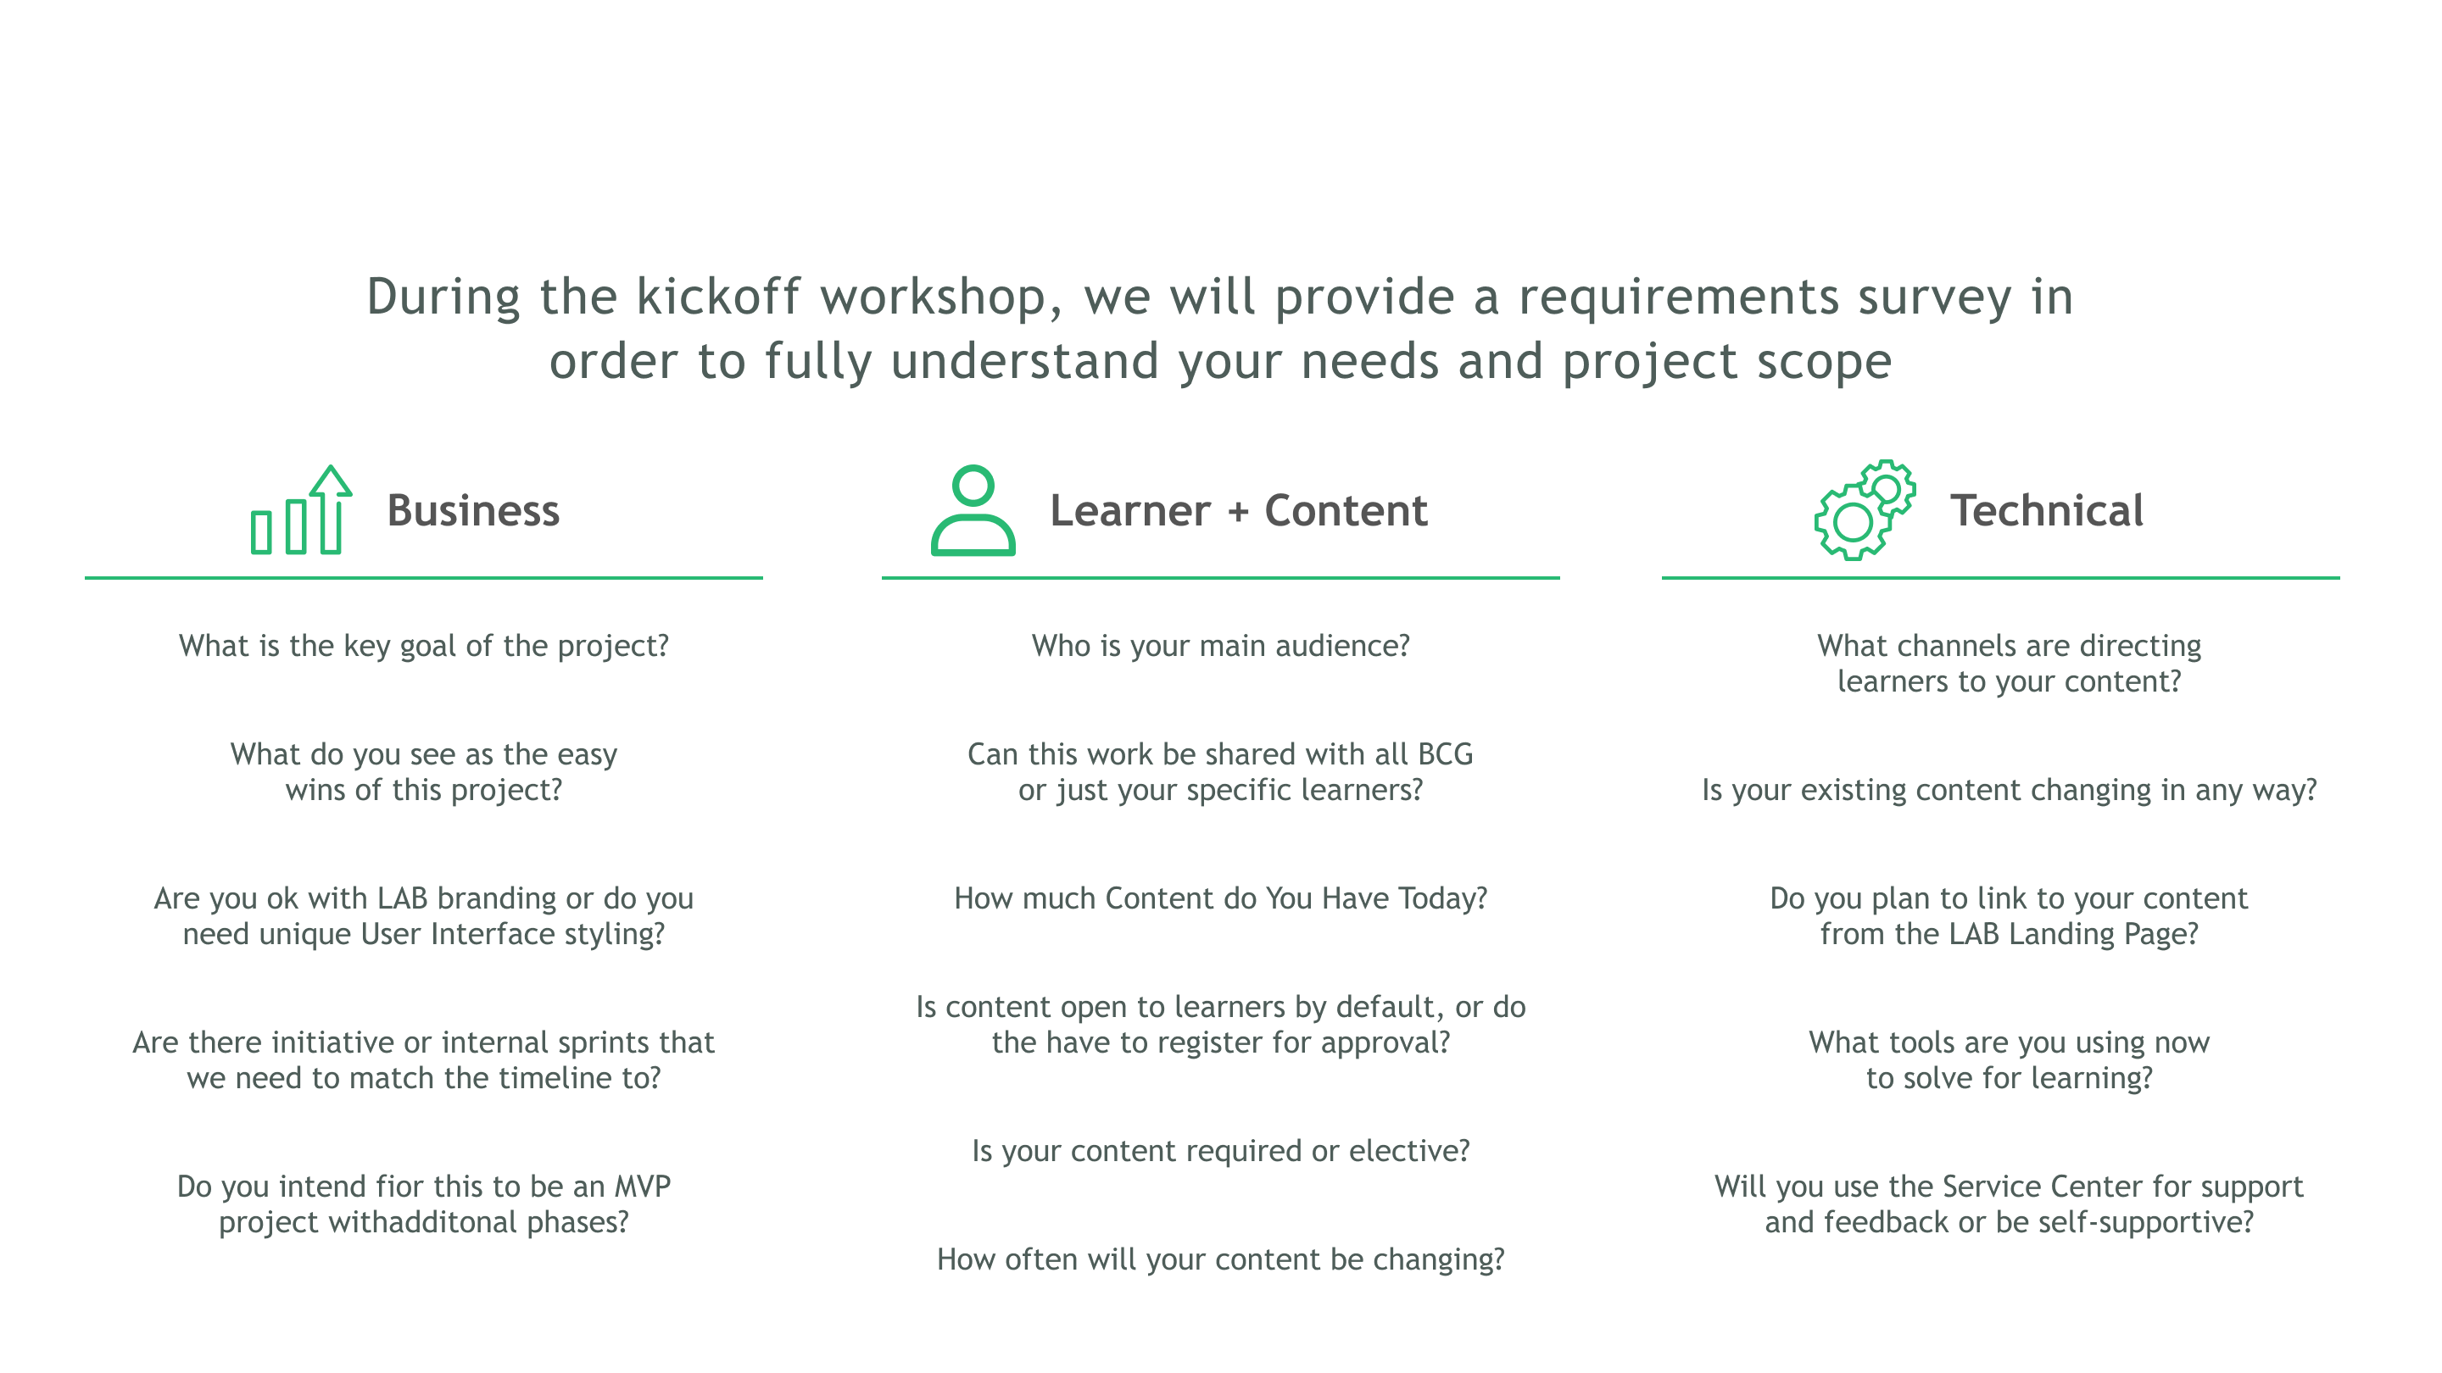
Understanding Your Needs

Slide 14
Operations
RP 15.Sep.20: I think we should include and I added some notes to the previous slides on this.
I feel that the resourcing and skills ABMs have for the operations in ongoing basis will drive a lot of the decisions when we plan the scope for implementation. Depending on their resources & skills they might need to take more basic approach – or they might be able to be very independent and push LAB to it's limits with designs etc.
Shobhit 16.Sep.20: It's definitely worth including, especially if we can use it to highlight what options are available for L&D teams to upskill / certify on Saba Cloud features. This would be key to the self-service option.

Slide 15
Executing on your LAB initiative
VK 12.Feb.21: Charles to add
Guidelines on requirements, resourcing, support
From PO:
I agree we need 2 sections for the resourcing:
what is needed for implementation phase from both the ABM (do they have web design, UI/UX, design studio expertise) and from 'us'
what is needed for RtB mode. And here we need clarity from L&D team; what support they can offer in ongoing basis (content uploads, visuals for announcements etc.) and from systems team (do we offer the service to update their workspaces and announcements or do we give access & train someone from ABM to do this on their own)
We should include a note that the technical tickets will be managed via ServiceNow.
However, ABM might have their own support channel for other learning related issues so instead of directing them to learning@bcg.com we might need to link them somewhere else..

Slide 16
LABcasts are categorized into three service levels
VK 28.Sep.20: Self-service, joint collaboration and centralized
DIY
Basic
Advanced
LABcasts team provides limited support (stakeholder driven)
Resources provided for content standards and best practices shared
No dedicated content development support
No dedicated recording support
Series metrics provided
LABcasts team provides support for recording
Regular check-ins to support series and content structure
Recording scheduling and support provided
No dedicated content development support
Series metrics provided
LABcasts team provides content and recording support
Content development support through season 1
Recording scheduling and support provided
Series metrics provided

Slide 17



For more information and support
Learning Team microsite
learningteam.bcg.com
Slack us!
#learning_at_bcg
Visit the LAB support page
lab.bcg.com
Email us
learning@bcg.com

Slide 18
Next steps
UPDATED
Schedule time with the LABcasts team to:
Have a full demo of the LAB platform
Discuss your LAB needs
Determine what service level your project fall into
Determine if you need to provide budget
VK 28.Sep.20: For demo:
Shobhit 16.Sep.20: do we want to highlight the search, browse and quick links?
VK 24.Sep.20: Search -> tags, filters
Browse -> categories

Slide 19
Appendix

Slide 20
Available portlets glossary
VK 12.Feb.21: Charles to add
VK 11.Sep.20: Placeholder
Should we include?
Shobhit 16.Sep.20: Could also include some resources to familiarize audience with Saba Cloud – LAB modules, other guides, slack channels

